Slide 1
Customer support-Automation of ticket creation
PIP104 University Project-II
Review-4
Batch Number: CCS-G31
Roll Number | Student Name
20211ccs0086 | Mohammad T
20211ccs0066 | Greeshma R
20211ccs0060 | Mubarak
20211ccs0054 | Vignesh G
20211ccs0041 | Mohammed Faizan
Under the Supervision of,
Professor: Dr. Syed Siraj Ahmed
School of Computer Science & Engineering
Presidency University

Slide 2
Introduction
Current Challenges in Ticket Management: Traditional ticket handling systems struggle to meet the demands of increasing customer inquiries. Manual processes often result in delays, inefficiencies, and lower customer satisfaction levels.
Proposed Solution: Harnessing the power of Artificial Intelligence (AI) and Machine Learning (ML), the proposed solution automates ticket routing, prioritization, and response generation, significantly reducing human involvement while enhancing accuracy.
Advanced Technologies: With state-of-the-art tools like GPT-powered systems, Retrieval-Augmented Generation (RAG), and advanced NLP techniques, the solution delivers intelligent, context-aware responses and scales effortlessly for high-volume operations.
Key Benefits: Accelerated ticket resolution, enhanced customer satisfaction, and streamlined workflows enable support teams to allocate resources to more critical and high-value tasks.

Slide 3
Literature Review
Streamlined Ticket Classification: AI-powered models like transformers and AutoML significantly improve the accuracy and
speed of ticket classification, reducing manual workload.
Enhanced Customer Satisfaction: Intelligent systems provide faster responses and personalized support,
enhancing the overall customer experience.
Real-time Issue Resolution: Frameworks like ICS-Assist and TaDaa recommend solutions in real-time,
aiding agents in resolving issues more efficiently.
Natural Language Processing (NLP): NLP algorithms analyze customer queries to automatically prioritize,
route, and respond to tickets.
Cost and Time Efficiency: Automation reduces response times, operational costs, and human intervention in repetitive tasks.
Scalable and Adaptive Systems: AI-driven ticketing solutions are scalable, adapting to growing data volumes and changing business needs.
Future Potential: Continuous advancements in machine learning and NLP promise further enhancements in predictive
analytics, proactive customer support, and self-healing systems.

Slide 4
Proposed Method
AI-Driven Ticket Management: By integrating advanced AI models, Natural Language Processing (NLP), and Machine Learning (ML), the system automates ticket creation, classification, and response generation from incoming emails.
Retrieval-Augmented Generation (RAG): The implementation enhances response accuracy by retrieving relevant information from a vast repository, including customer feedback, prior tickets, and queries, ensuring context-aware and informed actions.
LangChain & LangGraph Integration: These frameworks facilitate efficient language model chaining and graph-based workflows, enabling parallel processing, automated ticket updates, and seamless decision-making.
Cloud Feedback Storage & Gemini AI: Feedback data is securely stored in the cloud for scalability, with Gemini AI employed for advanced analytics and processing. This ensures improved insights, better predictions, and a continually optimized customer service process.
This robust combination of technologies ensures faster resolutions, enhanced feedback analysis, and an overall improved customer experience.

Slide 5
Objectives
AI-Powered Automated Ticketing System
This advanced system leverages cutting-edge technologies like Natural Language Processing (NLP), Retrieval-Augmented Generation (RAG), and workflow automation frameworks to streamline customer complaint management. Its key features include:
Automated Ticket Creation:
Automatically parses customer emails to generate tickets with relevant details, significantly reducing manual effort.
Enhanced Accuracy with Retrieval-Augmented Generation (RAG):
Retrieves historical ticket data to generate accurate and informed responses or solutions by referencing previous case resolutions.
Optimized Workflows using LangChain and LangGraph:
Orchestrates complex decision-making processes such as intelligent ticket routing based on sentiment and urgency.
Automates email follow-ups for incomplete ticket details, improving efficiency.
Scalable Parallel Processing:
Ensures the system can manage high volumes of complaints and queries efficiently, maintaining performance as workload scales.
Improved Customer Experience:
Utilizes AI-driven sentiment analysis to prioritize tickets and deliver contextually accurate, timely responses, leading to faster resolutions and greater customer satisfaction.
This integrated solution ensures a seamless, efficient, and customer-centric approach to complaint management.

Slide 6
Methodology
Steps for Implementing the AI-Powered Automated Ticketing System
Email Parsing and Ticket Creation:
Leverage Natural Language Processing (NLP) to analyze incoming emails.
Extract essential details like customer ID, issue type, and priority.
Automatically create tickets with all relevant information, minimizing manual intervention.
Retrieval-Augmented Generation (RAG):
Retrieve pertinent data from historical ticket records or databases.
Reference similar cases and their resolutions to generate accurate and informed responses.
LangChain and LangGraph for Workflow Automation:
Use LangChain and LangGraph to streamline complex workflows, such as:
Following up on tickets with incomplete details.
Routing tickets intelligently based on sentiment, urgency, or issue type.
Generating automated responses using predefined templates.
Parallel Processing for Scalability:
Implement parallel processing techniques to handle multiple incoming queries simultaneously.
Ensure the system remains responsive and efficient even with increased ticket volumes.
These steps collectively ensure a robust, scalable, and intelligent system for managing customer complaints efficiently.

Slide 7
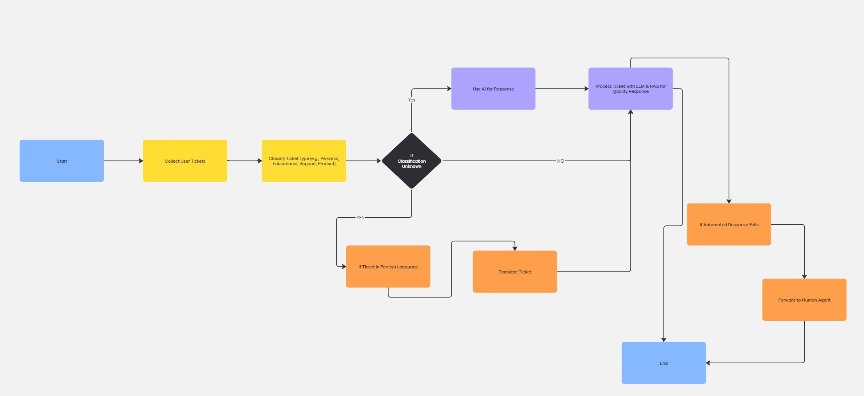

Slide 8
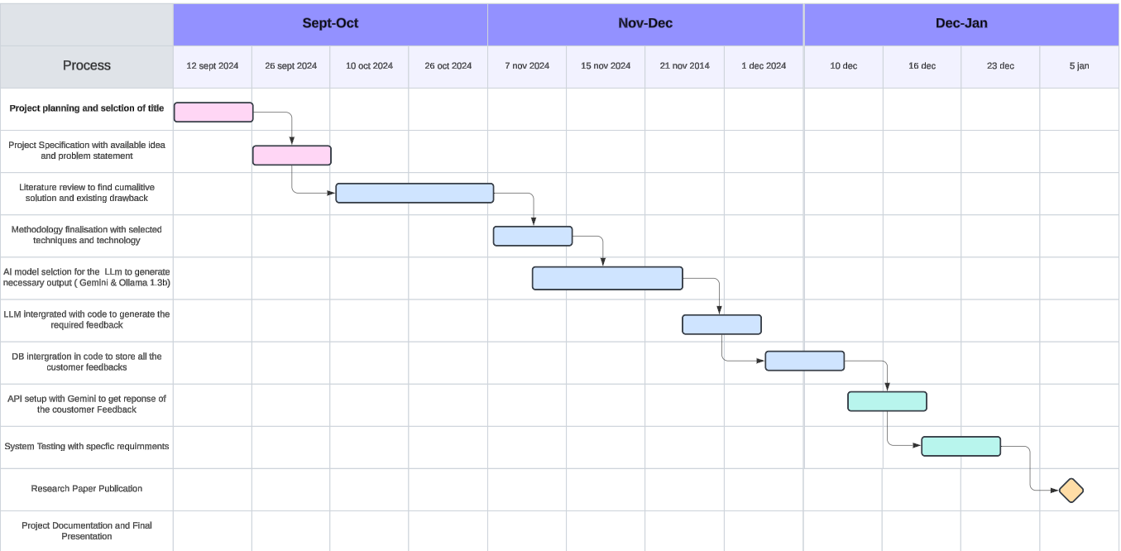
Timeline of Project

Slide 9
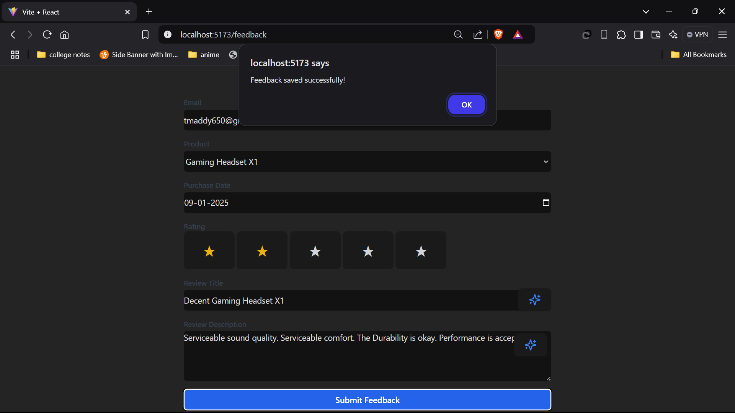
Outputs

Slide 10
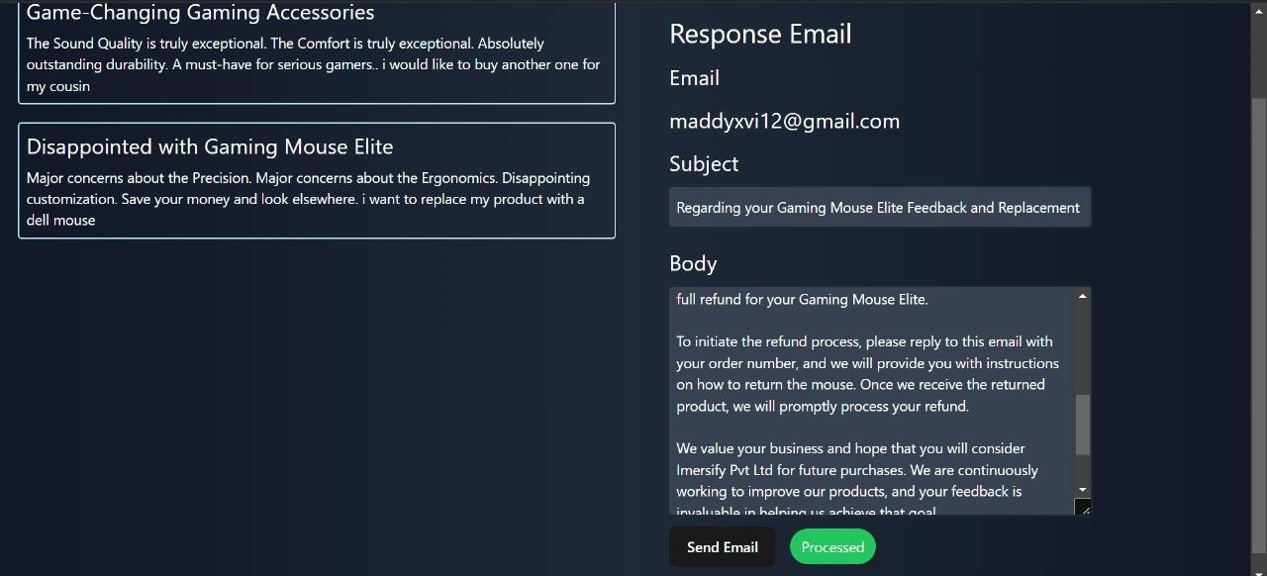

Slide 11
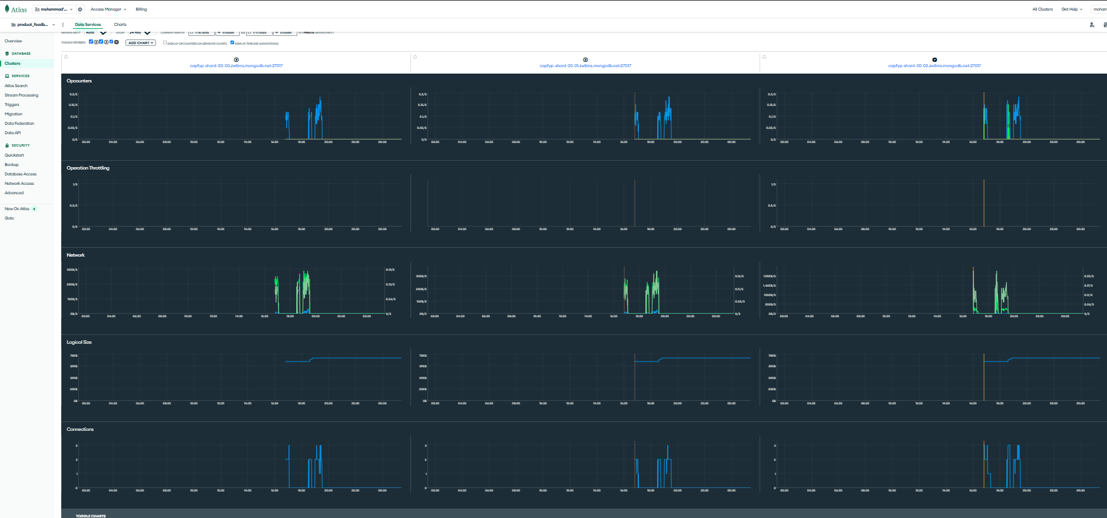

Slide 12
Future Work
Model Enhancement:
Further fine-tune the AI model with data specific to customer support domains for greater accuracy.
Extend capabilities to support multiple languages and improve sentiment detection for diverse audiences.
Dataset Expansion:
Build a larger, diversified dataset with tickets and complaints from various industries.
Include AI-generated variations and edge cases to enhance the model's robustness.
Advanced Tool Integration:
Incorporate advanced frameworks like LangChain and LangGraph to refine multi-step workflows and
contextual ticket analysis.
Leverage cutting-edge sentiment and urgency detection tools to improve ticket prioritization.
Scalable Deployment:
Develop scalable, cloud-based solutions with real-time ticketing capabilities.
Introduce mobile-friendly and user-accessible applications for seamless integration with customer-facing platforms.
Enhanced User Experience:
Provide interactive dashboards for customer support teams to monitor, manage, and resolve tickets effectively.
Integrate feedback mechanisms to continuously improve system performance and user satisfaction.

Slide 13
Conclusion
The AI-powered automated ticketing system, built with advanced frameworks like LangChain, LangGraph, and RAG, revolutionizes customer support by automating ticket creation, routing, and resolution. With the integration of NLP and sentiment analysis, the system ensures customer complaints are prioritized and addressed with contextually accurate and personalized responses.
Scalability is achieved through parallel processing, allowing the system to manage high ticket volumes seamlessly while maintaining speed and accuracy. Intelligent automation handles follow-up tasks, retrieves historical data, and generates efficient, template-based responses, significantly reducing resolution times and operational dependencies.
By minimizing manual intervention, the system not only lowers operational costs but also improves service quality. Additionally, AI-driven analytics offer actionable insights into ticket trends, enabling continuous optimization of processes and better decision-making. This holistic approach ensures a seamless customer experience, operational efficiency, and long-term scalability for businesses.

Slide 14
References
https://www.researchgate.net/publication/337509813_A_Study_in_the_Automation_of_Service_Ticket_Recognition_using_Natural_Language_Processing
https://ieeexplore.ieee.org/ielx7/6287639/8948470/09234428.pdf
https://jcoms.fesb.unist.hr/pdfs/v17n1_1024_tolciu.pdf
https://www.researchgate.net/publication/337509813_A_Study_in_the_Automation_of_Service_Ticket_Recognition_using_Natural_Language_Processing
https://www.researchgate.net/publication/339986693_AI-based_chatbots_in_customer_service_and_their_effects_on_user_compliance
https://www.researchgate.net/publication/381461839_Retrieval_Augmented_Generation_RAG_based_Restaurant_Chatbot_with_AI_Testability
https://www.scitepress.org/Papers/2024/128072/128072.pdf
https://www.researchgate.net/publication/381036706_Application_of_Chatbots_and_Virtual_Assistants_in_Ticket_Booking_System
https://www.sciencedirect.com/science/article/abs/pii/S1567422321000703https://www.researchgate.net/publication/371057143_Design_and_Implementation_of_an_AI_Chatbot_for_Customer_Service
https://www.emerald.com/insight/content/doi/10.1108/REGE-07-2021-0120/full/html
https://ceur-ws.org/Vol-3239/paper17.pdf
https://www.darpa.mil/attachments/AIFull.pdf

Slide 15
Thank You

